Slide 1

Research Computing Supercomputing Spin Up

Slide 2

Supercomputing Spinup Part I: Working with Linux
Workshop Type: Primer
Instructor: Trevor Hall
Contact: rc-help@colorado.edu
Website: https://www.colorado.edu/rc
Slides and other files available for download and viewing:
https://github.com/ResearchComputing/Supercomputing_Spinup

Slide 3

RMACC Cyber Infrastructure Portal
https://ask.cyberinfrastructure.org/c/rmacc/65
This forum provides opportunity for RMACC members to converse amongst themselves and with the larger, global research computing community.
The “go to” general Q&A platform for the global research computing community - researchers, facilitators, research software engineers, CI engineers, sys admins and others.

Slide 4
Working with Linux Outline
Intro to Research Computing
Opening a Terminal
Why use Linux
Basic Linux commands
File editing
Linux filesystems
Environment variables
Modes (aka Permissions)
Intro to the shell and shell scripts
File editing
Bash scripting basics

Slide 5
What is Research Computing?
Provide services for researchers that include:
- Large scale computing
- Data storage
- High speed data transfer
- Data management support
- Consulting
- Training
Our compute clusters include Alpine and Blanca ”condo” cluster
Archive and active storage provided by PetaLibrary

Slide 6
HPC Cluster: Alpine
Alpine is the 3rd-generation HPC cluster at CURC, following:
Janus
RMACC Summit
Alpine is a heterogeneous cluster with hardware currently provided by CU Boulder, CSU, and Anschutz Medical Campus
Access is available to CU Boulder, CSU, AMC, and RMACC users
Alpine

Slide 7
Opening a Terminal
Mac: Go to Applications → Utilities → Terminal
Windows: Download a terminal emulator (or use Powershell)
- PuTTY: https://www.putty.org
- Git BASH: https:gitforwindows.org
- Open OnDemand: https://ondemand.rc.colorado.edu/
- RMACC: https://ondemand-rmacc.rc.colorado.edu/
Notes:
https://curc.readthedocs.io/en/latest/access/logging-in.html

Slide 8
Logging into CURC
ssh <identikey>@login.rc.colorado.edu
Enter your identikey password
Authenticate by accepting the Duo push to your smartphone
- Can also authenticate by text message, phone call, or token
More info here: https://curc.readthedocs.io/en/latest/access/logging-in.html

Slide 9
What happens when you log in?
Login is authenticated (password or key)
Assigned to a tty
Shell starts
Environment is set up
“Message of the Day” prints
Prompt
Notes:
tty - teletypewriter

Slide 10

What is Linux?
Part of the Unix-like family of operating systems.
Started in early ‘90s by Linus Torvalds.
Typically refers only to the kernel with software from the GNU project and elsewhere layered on top to form a complete OS. Most is open source.
Software
Software
Software
Software
OS Kernel
Hardware
images courtesy of wikicommons
Notes:
The Linux kernel is the main component of a Linux operating system (OS) and is the core interface between a computer’s hardware and its processes. It communicates between the 2, managing resources as efficiently as possible.

Slide 11




What is Linux?
Several distributions are available from enterprise-grade, like RHEL or SUSE, to more consumer-focused, like Ubuntu.
Runs on everything from embedded systems to supercomputers.
Software
Software
Software
Software
OS Kernel
Hardware
images courtesy of wikicommons
Notes:
Red Had Enterprise Linux
Software- und System-Entwicklung (Software and Systems Development)

Slide 12
Why Use Linux?
Default operating system on virtually all HPC systems and the foundation for many business services globally
Extremely flexible
Fast and powerful
Many tools for software development
You can get started with a few basic commands and build from there
Notes:
Add that Linux is open source

Slide 13
Anatomy of a Linux command
command [flags] [target(s)]
ls –l myworkdir/
Case is important!
Help on commands is available through the “man” command (short for manual)
man ls
Notes:
-l : Displays the mode, number of links, owner, group, size (in bytes), and time of last modification for each file
-L: Lists the file or directory contents that the link references. This is the default action.

Slide 14
The Linux Filesystem
System of arranging files on disk
Consists of directories (folders) that can contain files or directories
Levels in full paths separated by forward slashes:
e.g. /home/user/scripts/analyze_data.sh
Case-sensitive; spaces in names discouraged
Some shorthand:
. (the current directory)
.. (the directory one level above)
~ (home directory)
- (previous directory, when used with cd)

Slide 15






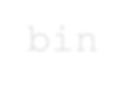












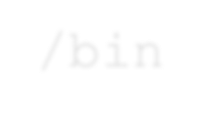









Multiple Users
Filesystem
/
bin
usr
home
/local
/<username>
Relative path
../../usr/local
/bin
/documents
/hpc
/usr/local/bin
Absolute path
/notes.txt
/home/<username>/documents/hpc/notes.txt

Slide 16
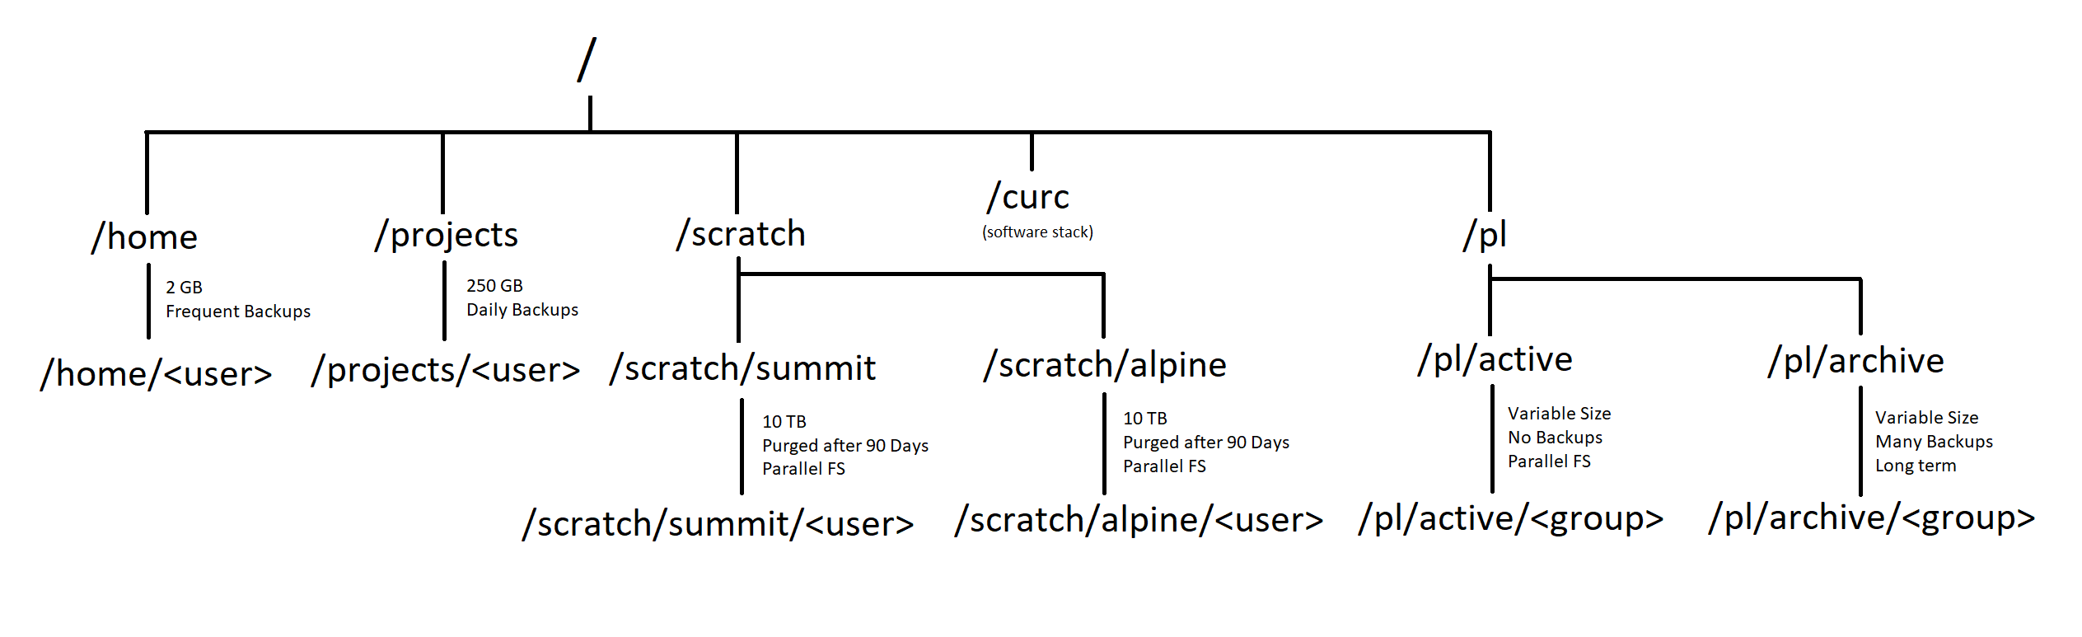
Your personal directories on CURC
Notes:
Home: Good for ‘can’t lose’ files
projects: good for storing scripts, self-installed software, some data
scratch- no backed up! highly performant- good for jobs with lots of I/O

Slide 17
Environment variables
Environment variables store important information needed by Linux users and programs
Type env to see your currently set up environment variables
Useful environment variables:
PATH directories to search for commands
HOME home directory
PWD current working directory
USER username
LD_LIBRARY_PATH directories to search for dynamically-loaded libraries
Notes:
have them do echo $USER

Slide 18
File and Directory related commands
pwd– prints full path to current directory
cd – changes directory; can use full or relative path as target
mkdir – creates a subdirectory in the current directory
rmdir – removes an empty directory
rm – removes a file (rm -r removes a directory and all of its contents)
cp – copies a file
mv – moves (or renames) a file or directory
ls – lists the contents of a directory (ls -l gives detailed listing)

Slide 19
File-viewing commands
less– displays a file one screen at a time
cat – prints entire file to the screen
head – prints the first few lines of a file
tail – prints the last few lines of a file (with -f shows in realtime the end of a file that may be changing)
diff – shows differences between two files
grep – prints lines containing a string or other regular expression ps –df | grep xx
sort – sorts lines in a file
find – searches for files that meet specified criteria
wc – count words, lines, or characters in a file
Notes:
ps lists current running processes
Pipes: | sends output of one command to another command

Slide 20
Exercise 1: Navigation
Change to your projects directory without typing your user name out
Print the path to your current directory
List the contents of this directory
Change to your home directory and create a new directory (you can pick the name). How can you be sure the new directory is there?
Move the directory to your project space
Remove the directory you just created. Be careful!
Notes:
cd /projects/$USER
pwd
ls
cd ~
mkdir demo
ls
mv demo /projects/$USER
rmdir /projects/$USER/demo

Slide 21
Access the example scripts
How to get there: github.com/ResearchComputing/Supercomputing_Spinup
Navigate to your workspace and go into the scripts directory for our demos
Git clone the repository:
git clone https://github.com/ResearchComputing/Supercomputing_Spinup.git
Notes:
git clone https://github.com/ResearchComputing/Supercomputing_Spinup.git

Slide 22
Exercise 2: File Viewing
Change to the “linux_bash_spinup/scripts” directory
Print out the entire “test.sh” file
Print out the last 3 lines of “local_vs_global.sh” file
Find how many words are in “case_example.sh”
Notes:
cd /scratch/alpine/$USER/Supercomputing_Spinup/linux_bash_spinup/scripts
cat test.sh
tail -n 3 local_vs_global.sh (ten lines is default)
wc case_example.sh (lines,words,bytes)

Slide 23
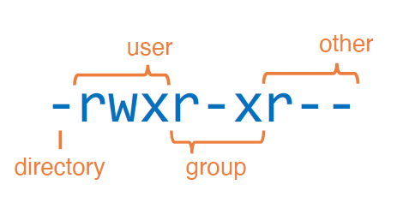
Modes (aka permissions)
View file/directory permissions ls -l
3 classes of users:
User (u)
Group (g)
Other (o)
aka “owner”
3 types of permissions:
Read (r)
Write (w)
Execute (x)
Notes:
d Means directory, - means file

Slide 24
Modes (continued)
chmod changes modes:
To add write and execute permission for your group:
chmod g+wx filename
To remove execute permission for others:
chmod o-x filename

Slide 25
Intro to Shells and Shell Scripts
A shell is the environment in which commands are interpreted in Linux.
GNU/Linux provides numerous shells; the most common is the Bourne Again shell (bash).
Other common shells available on Linux systems include:
sh, csh, tcsh, ksh, zsh
Shell scripts are files containing collections of commands for Linux systems that can be executed as programs.
Shell scripts are powerful tools for performing many types of tasks.
Notes:
If you have a newer mac and you’re working in the terminal, you might notice it’ll show you a message about zsh being the default shell

Slide 26
▶ Can be programmed interactively, directly on the terminal.
▶ It can also be programmed by script files. The first line of the file must contain #!/bin/bash
▶ The program loader recognizes the #! and will interpret the rest of the line (/bin/bash) as the interpreter program.
▶ If a line starts with #, it is a comment and is not run.
#!/bin/bash # the files in /tmp.
cd /tmp
ls
Shell to run
Comments
Change directories
List everything in /tmp
Notes:
The hello.sh file you chmod’d was a bash shell script.
This implies that the Bash script is running in a separate independent shell. This separate shell terminates at the end of the script, leaving the parent shell, the shell we’re in, unaffected.
pwd
echo $$
PID OF CURRENT PROCESS

Slide 27
Alternatives for Scripting
▶ csh/tcsh
▶ ksh
▶ perl
▶ python
▶ ruby
▶ make
C-shell (tcsh: updated version of csh)
Korn shell; related to sh/bash
exceptional text manipulation and parsing excellent for scientific and numerical work general scripting
building executables from source code

Slide 28
Exercise 3: Permissions and Running Bash Scripts
Change directory to ~/<repo for this class>
Use less to view the contents of hello_world.txt
Use cat to show the contents of hello.sh in bash_spinup/scripts
Try to run hello.sh by typing ./hello.sh at the command line
Add execute permission to hello.sh using chmod
Try to run hello.sh
Notes:
point out can also run with bash <script name>
cd /scratch/alpine/trha5176/Supercomputing_Spinup/linux_bash_spinup/scripts
less hello_world.txt (q)
cat hello.sh
./ hello.sh
chmod u+x hello.sh
./ hello.sh

Slide 29
File editing
nano – simple and intuitive to get started with; not very feature-rich; keyboard driven
vi/vim – universal; keyboard-driven; powerful but has a learning curve
emacs – keyboard or GUI versions; helpful extensions for programmers; well-documented
LibreOffice – for WYSIWYG
Use a local editor via an SFTP program to remotely edit files

Slide 30
File Editing with Nano
test.sh
type nano <filename> at the prompt.
You can edit text as you would in, e.g. MS Word.
When you are finished, type ctrl-o to write, ctrl-x to exit. See commands at the bottom of the screen.
How can we run the script?

Slide 31
Exercise 4: File Editing with Nano
Edit the contents of hello_world.txt contents with nano (you can edit it to say anything!)
Run the program “hello.sh” by typing bash hello.sh or ./hello.sh at the command line
Notes:
nano hello_world.txt
ctrl-o, ctrl-x
bash hello.sh

Slide 32
Bash Scripting Basics: Local vs. Global Variables
▶ A variable can contain a number, a character, a string of characters.
▶ Environment variables are global- carry forward to subsequent commands or shells
▶ Shell variables are local- only effective in the current shell itself
▶ A variable declared as local is one that is visible only within the block of code in which it appears. It has local "scope". In a function, a local variable has meaning only within that function block.
Notes:
I gave you the example of $USER being an environmental variable- it’s a variable stored in the system that’s there every time you login, no matter whether you’re on a compute node or the login node.
Variables that you set in your shell or shell script, on the other hand, are examples of local variables. Local variables are those whose scope is within the function where it is declared( can be accessed within the declared block or function in the program)

Slide 33
Exercise 5: Local Variables Scope
variables_scope.sh
Run it (make sure it’s executable)
Take a look at the file
Why did var2 change but var1 stayed the same?
Notes:
nano variables_scope.sh (ctrl x)
ls –l
chmod u+x variables_scope.sh
./variables_scope.sh

Slide 34
Thank you!
Documentation: curc.readthedocs.io/
Trainings with Center for Research Data and Digital Scholarship (CRDDS): https://www.colorado.edu/crdds/
Coming up:
Supercomputing Spin Up: Part 2 – Submitting Jobs (4/11)
Helpdesk: rc-help@colorado.edu
Consult Hours (Tuesday 12:00-1:00 in-person, Thursday 1:00-2:00 virtually)

Slide 35

Survey and feedback
http://tinyurl.com/curc-survey18

